Slide 1
ANALYZE INTERNATIONAL DEBT STATISITCS
PRESENTED BY :
SHUBHAM LODAM
ADITYA DESHMUKH

Slide 2
PROJECT OBJECTIVES
This project determines the international debt of various countries and analyse the data concluding which country has the maximum amount of debt and compare the various parameters from distinct countries to total international debt.

Slide 3



RESOURCES AND TOOLS UTILIZE TO BUILD THE PROJECT

Slide 4
PROBLEM STATEMENT
Developing countries in particular have to pay huge costs to service their debts, and those costs are borne by people living in extreme poverty. They had to deal with repayments made in hard currency. Developing countries have been hit hardest by the global recession. High fuel costs, high interest rates and declining exports made it increasingly difficult for them to service their debts.

Slide 5
OBJECTIVE
The aim is to minimize the interest cost of servicing debt to taxpayers and use it countercyclically as a stabilizing weapon to complement monetary and fiscal policy. This dataset contains information on the amount of debt (in US dollars) owed by developing countries across multiple categories. Objective is to analyze international debt data collected by the World Bank and determine the following objectives :
What is the total amount of debt that is owed by the countries listed in the dataset?
Which country owns the maximum amount of debt and what does that amount look like?
What is the average amount of debt owed by countries across different debt indicators?

Slide 6
BENEFITS
Overall International Debt Data
Total Debt Owed by Various Countries And Overall Countries
Average Amount By Different Countries Across Different Indicators
Highest Debt By Various Countries
Average Debt Across Indicators
Principal Repayments Across The Highest Average Debt
The Most Common Indicator

Slide 7
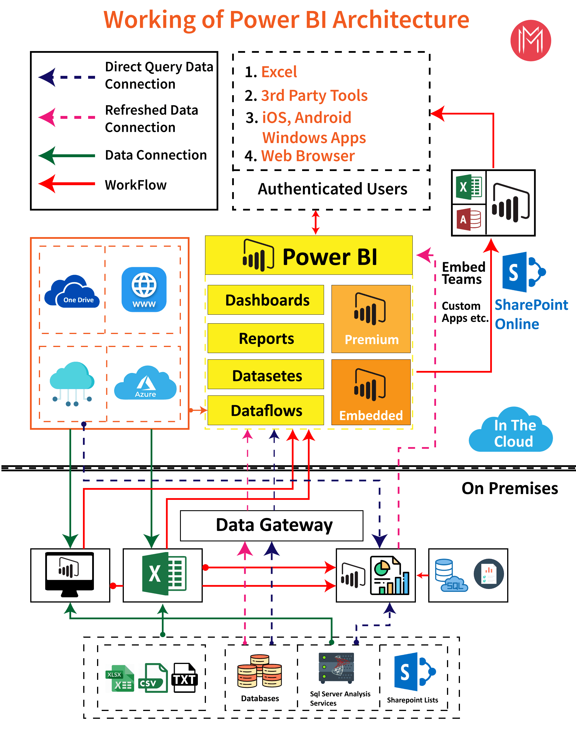
ARCHITECTURE

Slide 8
METHODOLOGY
Excel
Data Analyzation
MySQL
Data Manipulation
Power BI
Data Visualization

Slide 9
PROCESS FOR VISUALIZATION
Business Understanding:
When analyzing industry data, you should have a clear picture and understanding of what the industry does, what decisions it makes, and for what purpose the data is being analyzed. This entire data analysis process starts with the question
2. Acquiring The Raw Data:
This is the step of defining questions and then collecting data from various sources such as data warehouses, logs, and datasets to answer these questions. Raw data is queried to answer the question, but this is not the raw data set instead. It should be called raw data because it is not in the exact format you want to analyze.

Slide 10
3. Extracting The Data :
This step extracts the data to create the final dataset. This can guide further analytical processes. This is a clean record. MySQL is used to extract data from the database. Over 1 million databases queried to extract multi-row data. A database query language like MySQL makes it easy for analysts to analyze and transform data. SQL must be learned first as it allows us to work with datasets.
Transforming The Data:
Data transformation is the process of transforming data or data sets from one state or structure to another state structure. This is the basic form of data integration where data collected from various sources are integrated with specific structured data such that this process used in the target of the analytical process is known as ETL (Extract Transform Load). State.

Slide 11
Analyzing the data:
There are many tools and languages ​​available for doing data analysis, from very advanced like SAS, SPSS, Tableau, Python, R to very basic, simple and common like MS Excel.
Data visualization can use graphs, charts, tables, or images to convey information in an effective way. Data visualization techniques allow you to simplify and present even the most complex data in an easy-to-understand way.

Slide 12
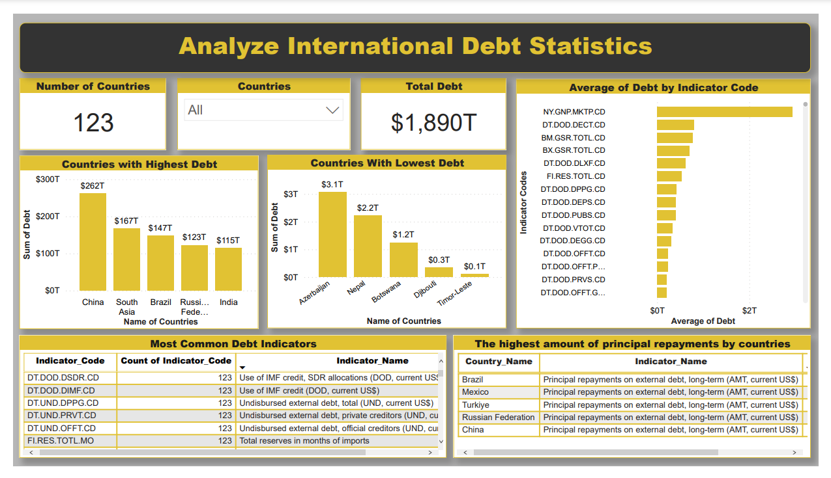
FINAL DASHBOARD

Slide 13
THANK YOU!!!

